Slide 1
Relational Query Optimization
SUN YAT-SEN UNIVERSITY
Notes:
1

Slide 2
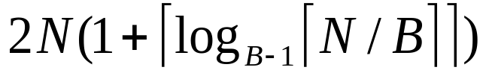
Review
单个关系运算的求值方法
  选择运算：cheapest access path（文件扫描、索引）
  投影运算: 消除重复（排序）
  连接运算：Nested Loops Join、Sort-Merge Join
相应的开销估算公式
  外排序
  块嵌套循环连接算法
  排序归并连接算法
Cost = [R] + [R]/N * [S]
Cost: Sort R + Sort S + ([R]+[S])

Slide 3
Review
Choice of single-table operations
  Depends on indexes, memory, stats,…
Joins
  Blocked nested loops:
    simple, exploits extra memory
  Indexed nested loops:
    best if 1 rel small and one indexed
  Sort/Merge Join
    good with small amount of memory, bad with duplicates
  Hash Join
    fast (enough memory), bad with skewed data

Slide 4
Query Optimization Overview
Query can be converted to relational algebra
  Relational Algebra converts to tree, joins form branches
SELECT S.sname
FROM Reserves R, Sailors S
WHERE R.sid=S.sid AND
R.bid=100 AND S.rating>5
sname
bid=100
rating > 5
sid=sid
π_{(sname)}σ_{(bid=100 ∧ rating > 5)} (Reserves  Sailors)
Reserves
Sailors
Each operator has implementation choices
Operators can also be applied in different order!
Notes:
4

Slide 5
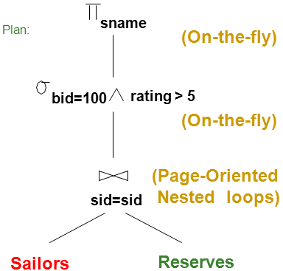
Query Optimization Overview (cont.)
Plan(执行计划,查询求解计划): Tree of Relation Algebra operations (and some others) with choice of algorithm for each operation.
Three main issues:
  For a given query,
  what plans are considered?
  How is the cost of a plan estimated?
  How do we “search” in the “plan space”?
Ideally: Want to find best plan.
Reality: Avoid worst plans!
Notes:
2

Slide 6
Cost-based Query Sub-System
Select *
From Blah B
Where B.blah = blah
Queries
Usually there is a
heuristics-based
rewriting step before
the cost-based steps.
Query Parser
Query Optimizer
Plan Generator
Plan Cost Estimator
Catalog Manager
Schema
Statistics
Query Executor

Slide 7
Schema for Examples
Sailors (sid: integer, sname: string, rating: integer, age: real)
Reserves (sid: integer, bid: integer, day: dates, rname: string)
Reserves:
  Each tuple is 40 bytes long, 100 tuples per page, 1000 pages.
  Assume there are 100 boats
Sailors:
  Each tuple is 50 bytes long, 80 tuples per page, 500 pages.
  Assume there are 10 different ratings
Assume we have 5 pages in our buffer pool!
  [R]=1000, p_{R}=100
  100 boats
  [S]=500, p_{S}=80.
  10 ratings
Notes:
3

Slide 8
Motivating Example
  [R]=1000, p_{R}=100
  100 boats
  [S]=500, p_{S}=80.
  10 ratings
  5 buffer pages
SELECT S.sname
FROM Reserves R, Sailors S
WHERE R.sid=S.sid AND
R.bid=100 AND S.rating>5
Plan:
sname
(On-the-fly)
实时流水线
Cost: 500+500*1000 I/Os=500,500 IOs
By no means the worst plan!
Misses several opportunities:
  selections could be`pushed’ down(下推)
  no use made of indexes
Goal of optimization: Find faster plans that compute the same answer.
bid=100
rating > 5
(On-the-fly)
Cost = [O] + [O] * [I]
(Page-Oriented
Nested loops)
sid=sid
Sailors
Reserves
Notes:
4

Slide 9
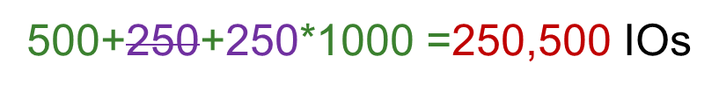
Alternative Plans – Push Selects
(No Indexes) 下推选择
  [R]=1000, p_{R}=100
  100 boats
  [S]=500, p_{S}=80.
  10 ratings
  5 buffer pages
Cost = [O] + [O] * [I]
(On-the-fly)
sname
sname
(On-the-fly)
实时流水线
bid=100
(On-the-fly)
bid=100
rating > 5
(On-the-fly)
(Page-Oriented
Nested loops)
(Page-Oriented
Nested loops)
sid=sid
sid=sid
rating > 5
(On-the-fly)
Reserves
Sailors
Reserves
Sailors
500,500 IOs
Notes:
5

Slide 10
  [R]=1000, p_{R}=100
  100 boats
  [S]=500, p_{S}=80.
  10 ratings
  5 buffer pages
Alternative Plans – Push Selects
(No Indexes)
Cost = [O] + [O] * [I]
(On-the-fly)
(On-the-fly)
sname
sname
bid=100
(On-the-fly)
rating > 5
(On-the-fly)
(Page-Oriented
Nested loops)
(Page-Oriented
Nested loops)
sid=sid
sid=sid
rating > 5
bid=100
(On-the-fly)
Sailors
(On-the-fly)
Reserves
Sailors
Reserves
250,500 IOs
1000 +10*500=6000 IOs
Notes:
5

Slide 11
Alternative Plans – Push Selects
(No Indexes)
  [R]=1000, p_{R}=100
  100 boats
  [S]=500, p_{S}=80.
  10 ratings
  5 buffer pages
Cost = [O] + [O] * [I]
(On-the-fly)
sname
(On-the-fly)
sname
rating > 5
(On-the-fly)
(Page-Oriented
Nested loops)
sid=sid
(Page-Oriented
Nested loops)
sid=sid
(Scan &
Write to
temp T2)
bid=100
rating > 5
bid=100
Sailors
(On-the-fly)
(On-the-fly)
Reserves
Sailors
Reserves
6000 IOs
1000 + 500+ 250 + (10 * 250)=4250 IOs
Notes:
5

Slide 12
  [R]=1000, p_{R}=100
  100 boats
  [S]=500, p_{S}=80.
  10 ratings
  5 buffer pages
Alternative Plans – Push Selects
(No Indexes)
Cost = [O] + [O] * [I]
(On-the-fly)
(On-the-fly)
sname
sname
(Page-Oriented
Nested loops)
(Page-Oriented
Nested loops)
sid=sid
sid=sid
(Scan &
Write to
temp T2)
(Scan &
Write to
temp T2)
bid=100
rating > 5
rating>5
bid=100
(On-the-fly)
(On-the-fly)
Reserves
Sailors
Sailors
Reserves
4250 IOs
500 + 1000 +10 +(250 *10)=4010 IOs
Notes:
5

Slide 13

More Alternative Plans
(No Indexes)
(On-the-fly)
sname
Cost: Sort R + Sort S + ([R]+[S])
(Sort-Merge Join)
sid=sid
(Scan;
(Scan;
write to
bid=100
rating > 5
write to
Sort Merge Join
With 5 buffers, cost of plan:
  Scan Reserves (1000) + write temp T1 (10 pages) = 1010.
  Scan Sailors (500) + write temp T2 (250 pages) = 750.
  Sort T1 (2*2*10) + sort T2 (2*4*250) + merge (10+250) = 2300
  Total: 4060 page I/Os.
If use BNL join, join = 10+4*250, total cost = 2770.
Can also `push’ projections, but must be careful!
  T1 has only sid, T2 only sid, sname:
  T1 fits in 3 pgs, cost of BNL under 250 pgs, total < 2000.
temp T1)
temp T2)
Reserves
Sailors
Cost = [O] + [O]/N * [I]
  [R]=1000, p_{R}=100
  100 boats
  [S]=500, p_{S}=80.
  10 ratings
  5 buffer pages
Notes:
5

Slide 14
Summing up
There are lots of plans
  Even for a relatively simple query
People tend to think they can pick good ones by hand
  MapReduce is based on that assumption
Not so clear that’s true!
  Machines are better at enumerating options than people
  But we will see soon how optimizers make simplifying assumptions

Slide 15
What is Needed for Optimization?
A closed set of operators
  Relational ops (table in, table out)
  Encapsulation (e.g. based on iterators)
Plan space
  Based on relational equivalences, different implementations
Cost Estimation, based on
  Cost formulas
  Size estimation, in turn based on
    Catalog information on base tables
    Selectivity (Reduction Factor) estimation
A search algorithm: To sift through the plan space and find lowest cost option!
Cost = [R] + [R]/N *[S]
  [R]=1000, p_{R}=100
  100 boats
  [S]=500, p_{S}=80.
  10 ratings
  5 buffer pages

Slide 16
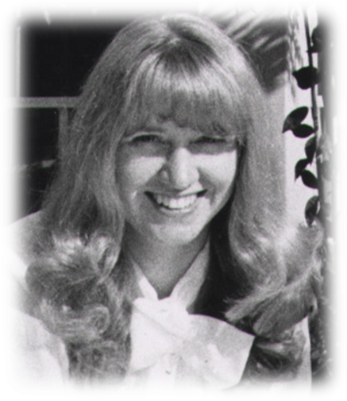
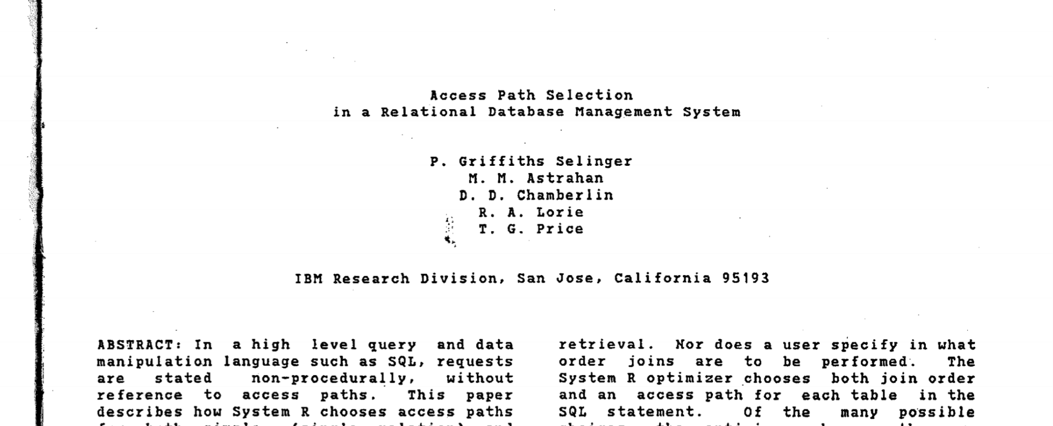
Query Optimization
Will focus on “System R” (Selinger) style optimizers

Slide 17
Highlights of System R Optimizer
Impact:
  Most widely used currently; works well for 10-15 joins.
Cost estimation:
  Very inexact, but works OK in practice.
  Statistics in system catalogs used to estimate cost of operations and result sizes.
  Considers combination of CPU and I/O costs.
Notes:
2

Slide 18
Highlights of System R Optimizer (Contd)
Plan Space: Too large, must be pruned.
  Many plans share common, “overpriced” subtrees
    ignore them all!
  In some implementations, only the space of left-deep plans (左深计划)is considered.
  Cartesian products avoided in some implementations.
Notes:
2

Slide 19
Query Blocks: Units of Optimization
查询块
SELECT S.sname
FROM Sailors S
WHERE S.age IN
(SELECT MAX (S2.age)
FROM Sailors S2
GROUP BY S2.rating)
Break query into query blocks
Optimized one block at a time
Uncorrelated nested blocks computed once
Correlated nested blocks like function calls
  But sometimes can be “decorrelated”
  Beyond the scope of introductory course!
Outer block
Nested block
For each block, the plans considered are:
  All available access methods, for
  each relation in FROM clause.
  All left-deep join trees
    right branch always a base table
    consider all join orders and join methods
D
C
A
B
Notes:
7

Slide 20
Schema for Examples
Sailors (sid: integer, sname: string, rating: integer, age: real)
Reserves (sid: integer, bid: integer, day: dates, rname: string)
Reserves:
  Each tuple is 40 bytes long, 100 tuples per page, 1000 pages. 100 distinct bids.
Sailors:
  Each tuple is 50 bytes long, 80 tuples per page, 500 pages. 10 ratings, 40,000 sids.
  [R]=1000, p_{R}=100
  100 boats
  [S]=500, p_{S}=80.
  10 ratings
  40,000 sids
Notes:
3

Slide 21
Translating SQL to Relational Algebra
SELECT S.sid, MIN (R.day)
FROM Sailors S, Reserves R, Boats B
WHERE S.sid = R.sid AND R.bid = B.bid AND B.color = “red”
GROUP BY S.sid
HAVING COUNT (*) >= 2
For each sailor with at least two reservations for red boats, find the sailor id and the earliest date on which the sailor has a reservation for a red boat.
Notes:
7

Slide 22
Translating SQL to Relational Algebra
SELECT S.sid, MIN (R.day)
FROM Sailors S, Reserves R, Boats B
WHERE S.sid = R.sid AND R.bid = B.bid AND B.color = “red”
GROUP BY S.sid
HAVING COUNT (*) >= 2
π
S.sid, MIN(R.day)
(HAVING _{COUNT(*)>2} (
GROUP BY _{S.Sid} (
σ_{B.color = “red”} (
Sailors Reserves Boats))))
Notes:
7

Slide 23
Relational Algebra Equivalences
Allow us to choose different join orders and to `push’ selections and projections ahead of joins.
Selections:
  σ_{c1∧…∧cn}(R) ≡ σ_{c1}(…(σ_{cn}(R))…) (cascade-级联)
  σ_{c1}(σ_{c2}(R)) ≡ σ_{c2}(σ_{c1}(R)) (commute-交换律)
Projections:
  π_{a1}(R) ≡ π_{a1}(…(π_{a1, …, an}(R))…) (cascade)
Cartesian Product
  (R × S) × T ≡ R × (S × T) (associative-结合律)
  R × S ≡ S × R (commutative)
  This means we can do joins in any order.
Notes:
10

Slide 24

More Equivalences
sname
bid=100
rating > 5
sid=sid
Eager projection
  Can cascade and “push” some projections thru selection
  Can cascade and “push” some projections below one side of a join
  Rule of thumb: can project anything not needed “downstream”
Selection on a cross-product is equivalent to a join.
  If selection is comparing attributes from each side
A selection on attributes of R commutes with R S.
  i.e., σ(R S) ≡ σ(R) S
  but only if the selection doesn’t refer to S!
Sailors
Reserves
Notes:
11

Slide 25
Cost Estimation
sname
bid=100
rating > 5
sid=sid
Sailors
Reserves
For each plan considered, must estimate total cost:
  Must estimate cost of each operation in plan tree.
    We’ve already discussed this for various operators
      sequential scan, index scan, joins, etc.
    Depends on input cardinalities(基数).
  Must estimate size of result for each operation in tree!
    Use information about the input relations.
Q: Is “cost” the same as estimated “run time”?
Cost = [R] + [R]/N *[S]
Notes:
8

Slide 26
Statistics and Catalogs
Need infomation on relations and indexes involved.
Catalogs typically contain at least:
Catalogs updated periodically.
Modern systems do more
  keep more detailed information on data values, e.g., histograms
Statistic | Meaning
NTuples | # of tuples in a table (cardinality)
NPages | # of disk pages in a table
Low/High | min/max value in a column
Nkeys | # of distinct values in a column
IHeight | the height of an index
INPages | # of disk pages in an index
Notes:
8

Slide 27
Size Estimation and Selectivity
SELECT attribute list
FROM relation list
WHERE term1 AND ... AND termk
Max output cardinality = product of input cardinalities
Selectivity (sel) associated with each term
  Book calls selectivity “Reduction Factor” (RF)
  |output| / |input|
  reflects the impact of the term in reducing result size.
  Result cardinality = Max # tuples * ∏sel_{i}
Notes:
9

Slide 28
Reduction Factor Estimation
SELECT attribute list
FROM relation list
WHERE term1 AND ...
Result cardinality = Max # tuples * product of all RF’s.
Term col=value (given Nkeys(I) on col)
RF = 1/NKeys(I)
Term col1=col2 (handy for joins too…)
RF = 1/MAX(NKeys(I1), NKeys(I2))
Term col>value
RF = (High(I)-value)/(High(I)-Low(I))
  Implicit assumptions: values are uniformly distributed and terms are independent!
Note, if missing the needed stats, assume 1/10!!!
Notes:
9

Slide 29
Reduction Factors & Histograms
For better estimation, use a histogram
equiwidth
equidepth

Slide 30
Think Through Estimation for Joins
Term col1=col2
  RF = 1/MAX(NKeys(I1), NKeys(I2))
Q: Given R join S, what is result cardinality?
Two cases:
  Key for R, Foreign Key for S
    A common case, treat it specially! RF = 1/|R|
  join on non-key {A}
    For each r ∈ R, NTuples(S)/NKeys(A,S) result tuples
    so…(NTuples(R) * NTuples(S)) / NKeys(A,S)
    For each s ∈ S, NTuples(R)/NKeys(A,R)
    so… (NTuples(S) * NTuples(R)) / NKeys(A,R)
  If these two estimates differ, take the lower one!
    Q: Why?
R
S.{A}
r

Slide 31
Enumeration of Alternative Plans
There are two main cases:
  Single-relation plans (base case)
  Multiple-relation plans (induction)
Single-table queries include selects, projects, and grouping/aggregate operations:
  Consider each available access path (file scan / index)
    Choose the one with the least estimated cost
  Selection/Projection done on the fly
  Result pipelined into grouping/aggregation
Notes:
12

Slide 32
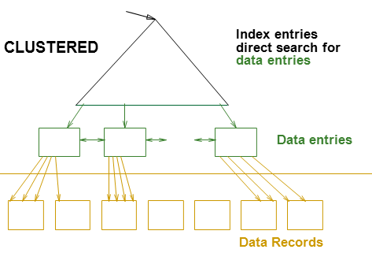
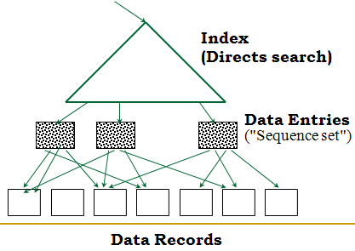
Cost Estimates for Single-Relation Plans
Index I on primary key matches selection:
  Cost is Height(I)+1 for a B+ tree.
Clustered index I matching one or more selects:
  (NPages(I)+NPages(R)) * product of RF’s of matching selects.
Non-clustered index I matching one or more selects:
  (NPages(I)+NTuples(R)) * product of RF’s of matching selects.
Sequential scan of file:
  NPages(R).
Recall: Must also charge for duplicate elimination if required
Notes:
13

Slide 33
Example
SELECT S.sid
FROM Sailors S
WHERE S.rating=8
  [R]=1000, p_{R}=100
  100 boats
  [S]=500, p_{S}=80.
  10 ratings
  5 buffer pages
If we have an index on rating:
  Cardinality = NTuples(S) * (1/NKeys(I)) = 40000 tuples * (1/10)
  Clustered index: (NPages(I)+NPages(S))* (1/NKeys(I))
  = (50+500) * (1/10) = 55 pages are retrieved. (This is the cost.)
  Unclustered index: (NPages(I)+NTuples(S))* (1/NKeys(I))
  = (50+40000) * (1/10) = 4005 pages are retrieved.
If we have an index on sid:
  Would have to retrieve all tuples/pages.
    With a clustered index, the cost is 50+500,
    with unclustered index, 50+40000.
Doing a file scan:
  We retrieve all file pages (500).
Notes:
14

Slide 34
Queries Over Multiple Relations
A System R heuristic:
only left-deep join trees considered.
  Restricts the search space
  Left-deep trees allow us to generate all fully pipelined plans.
    Intermediate results not written to temporary files.
    Not all left-deep trees are fully pipelined (e.g., SM join).
D
D
C
C
A
B
A
B
A
B
C
D
Notes:
15

Slide 35
Enumeration of Left-Deep Plans
Left-deep plans differ in
  the order of relations
  the access method for each relation
  the join method for each join.
Enumerated using N passes (if N relations joined):
  Pass 1: Find best 1-relation plan for each relation.
  Pass i: Find best way to join result of an (i -1)-relation plan (as outer) to the i’th relation. (i between 2 and N.)
For each subset of relations, retain only:
  Cheapest plan overall, plus
  Cheapest plan for each interesting order of the tuples.
D
C
A
B
Notes:
16

Slide 36
The Dynamic Programming
Table
  [R]=1000, p_{R}=100
  100 boats
  [S]=500, p_{S}=80.
  10 ratings
  5 buffer pages
Subset of tables in FROM clause | Interesting-order columns | Best plan | Cost
{R, S} | <none> | hashjoin(R,S) | 4500
{R, S} | <R.a, S.b> | sortmerge(R,S) | 7500

Slide 37
A Note on “Interesting Orders”
An intermediate result has an “interesting order” if it is sorted by any of:
  ORDER BY attributes
  GROUP BY attributes
  Join attributes of yet-to-be-added (downstream) joins

Slide 38
Enumeration of Plans (Contd.)
D
C
A
B
Match an i -1 way plan with another table only if
  there is a join condition between them, or
  all predicates in WHERE have been used up.
    i.e., avoid Cartesian products if possible.
ORDER BY, GROUP BY, aggregates etc. handled as a final step
  via `interestingly ordered’ plan if chosen (free!)
  or via an additional sort/hash operator
Despite pruning, this is exponential in #tables.
Notes:
16

Slide 39
Example
Sailors:
Hash, B+ on sid
Reserves:
Clustered B+ tree on bid
B+ on sid
Boats
B+ on color
Sid, COUNT(*) AS numbes
GROUPBY _{sid}
sid=sid
Select S.sid, COUNT(*) AS number
FROM Sailors S, Reserves R, Boats B
WHERE S.sid = R.sid AND R.bid = B.bid
AND B.color = “red”
GROUP BY S.sid
bid=bid
Sailors
Reserves
Color=red
Boats
Pass1: Best plan(s) for accessing each relation
  Reserves, Sailors: File Scan
  Q: What about Clustered B+ on Reserves.bid???
  Boats: B+ tree on color
Notes:
17

Slide 40
Pass 1
Find best plan for each relation in isolation:
  Reserves, Sailors: File Scan
  Boats: B+ tree on color
FROM Sailors S, Reserves R, Boats B

Slide 41
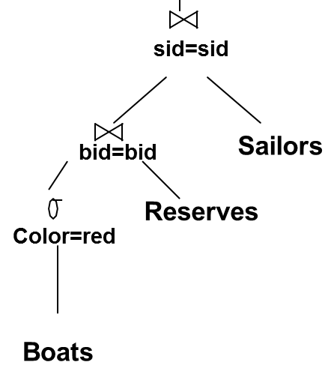
Pass 2
For each plan in pass 1, generate plans joining another relation as the inner, using all join methods (and matching inner access methods)
  File Scan Reserves (outer) with Boats (inner)
  File Scan Reserves (outer) with Sailors (inner)
  File Scan Sailors (outer) with Boats (inner)
  File Scan Sailors (outer) with Reserves (inner)
  Boats Btree on color with Sailors (inner)
  Boats Btree on color with Reserves (inner)
Retain cheapest plan for each (pair of relations, order)
FROM Sailors S, Reserves R, Boats B

Slide 42
Pass 3 and beyond
Sailors:
Hash, B+ on sid
Reserves:
Clustered B+ tree on bid
B+ on sid
Boats
B+ on color
Select S.sid, COUNT(*) AS number
FROM Sailors S, Reserves R, Boats B
WHERE S.sid = R.sid AND R.bid = B.bid
AND B.color = “red”
GROUP BY S.sid
Using Pass 2 plans as outer relations, generate plans for the next join
  E.g. Boats B+-tree on color with Reserves (bid) (sortmerge)
  inner Sailors (B-tree sid) sort-merge
Then, add cost for groupby/aggregate:
  This is the cost to sort the result by sid, unless it has already been sorted by a previous operator.
Then, choose the cheapest plan
FROM Sailors S, Reserves R, Boats B

Slide 43
Summary
Optimization is the reason for the lasting power of the relational system
But it is primitive in some ways
New areas: many!
  Smarter summary statistics (fancy histograms and “sketches”)
  Auto-tuning statistics,
  Adaptive runtime re-optimization (e.g. eddies),
  Multi-query optimization,
  And parallel scheduling issues, etc.

Slide 44
Summary
要求:
  理解查询树、执行计划树、关系代数等价规则、左深计划树和完全流水线计划树等概念
  深刻理解选择条件的选择性/缩减因子，进而能够估算结果集大小
  能够估算执行计划的开销
  理解左深计划的遍历算法
    若只有1、2关系，则能够找出最优计划

